Slide 1
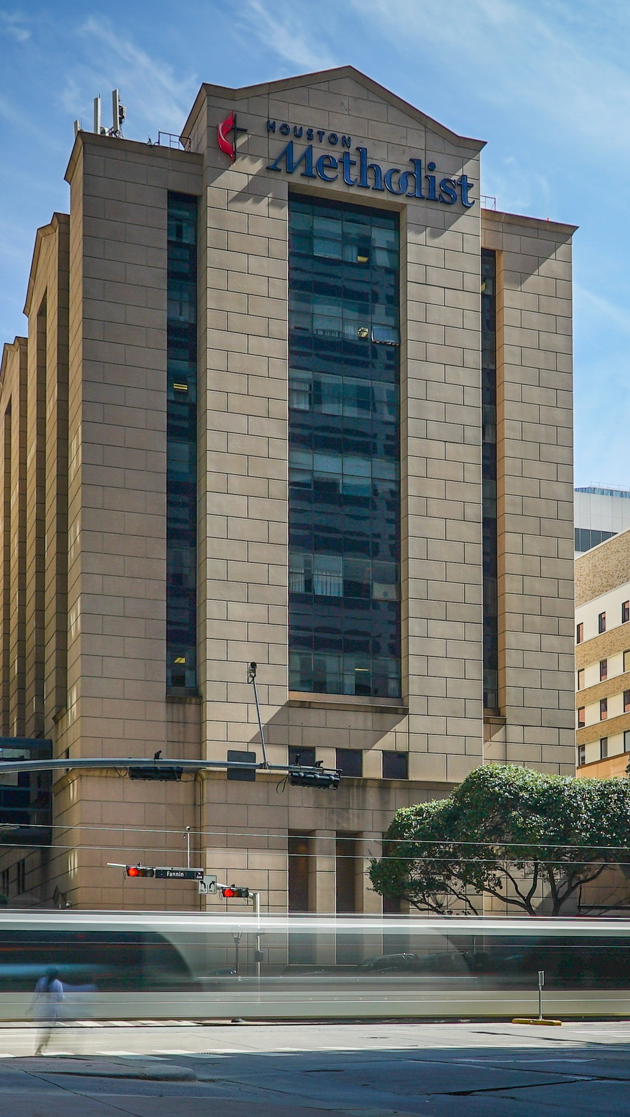


OPPORTUNITY REVIEW
DIRECT-TO-EMPLOYER GTM STRATEGY
Exploring a Houston Methodist DTE Health Plan

Slide 2
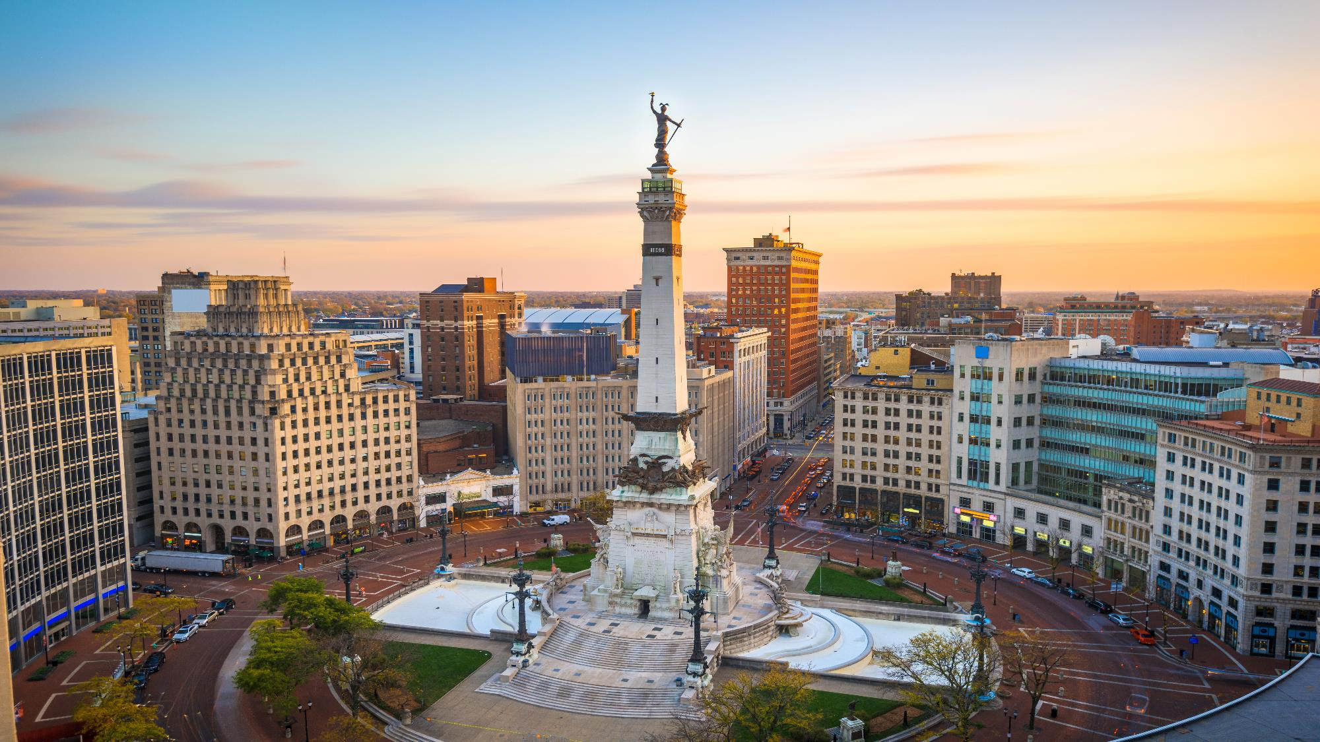

Founded in 1979, headquartered in Indianapolis
Largest Independently-Owned Full-Service Third-Party Administrator
Specialize in Administration of Self-Funded Plans and Population Health Management​
Leader in the Direct-to-Employer Movement
We Know and Understand the Market
Experience Working with All Professional Teams: Agents, Networks, MGAs
The Key Family of Companies is a Vertically Integrated group of benefit related organizations
3,000+ Corporate Clients
3 Million Members under Management
700 Employees

Slide 3


MARKET LEADER
IN
PRIVATE LABELED
DTE PLANS
Louisville, KY
Cincinnati, OH
Bentonville, AR
Knoxville, TN
Meridian, MS
Fort Myers, FL

Slide 4
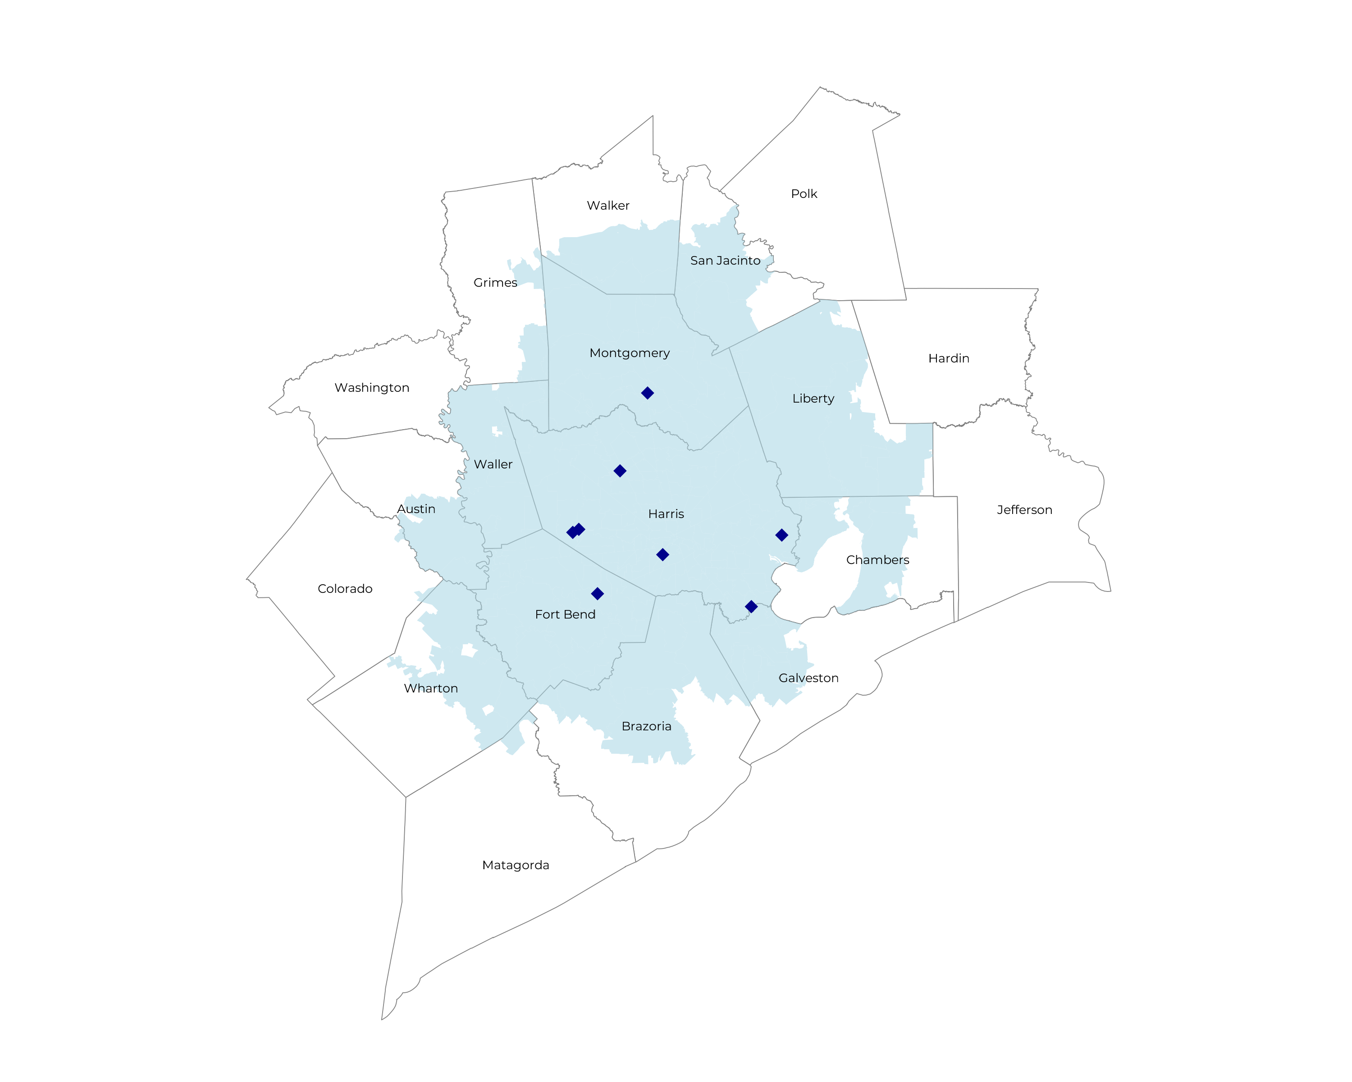
SIGNIFICANT OPPORTUNITY FOR PLAN GROWTH Researched for the below highlighted service area
Target Market 9000+ Employers 1.4M+ Employees 2.1M+ Members
 | Employer Size Group (# of Employees)
Commercial Employers With Headquarters | 50-100 | 101-200 | 201-400 | 401-1,000 | 1,001-3,000 | 3,000+
In Catchment Area | 4,642 | 2,085 | 1,448 | 765 | 295 | 193
Total Employees at Employers | 50-100 | 101-200 | 201-400 | 401-1,000 | 1,001-3,000 | 3,000+
Headquartered in Catchment Area | 348,200 | 312,800 | 434,400 | 535,500 | 590,000 | 1,158,000
Total Members with Employers | 50-100 | 101-200 | 201-400 | 401-1,000 | 1,001-3,000 | 3,000+
Headquartered in Catchment Area | 626,800 | 563,000 | 781,900 | 963,900 | 1,062,000 | 2,084,400

Slide 5
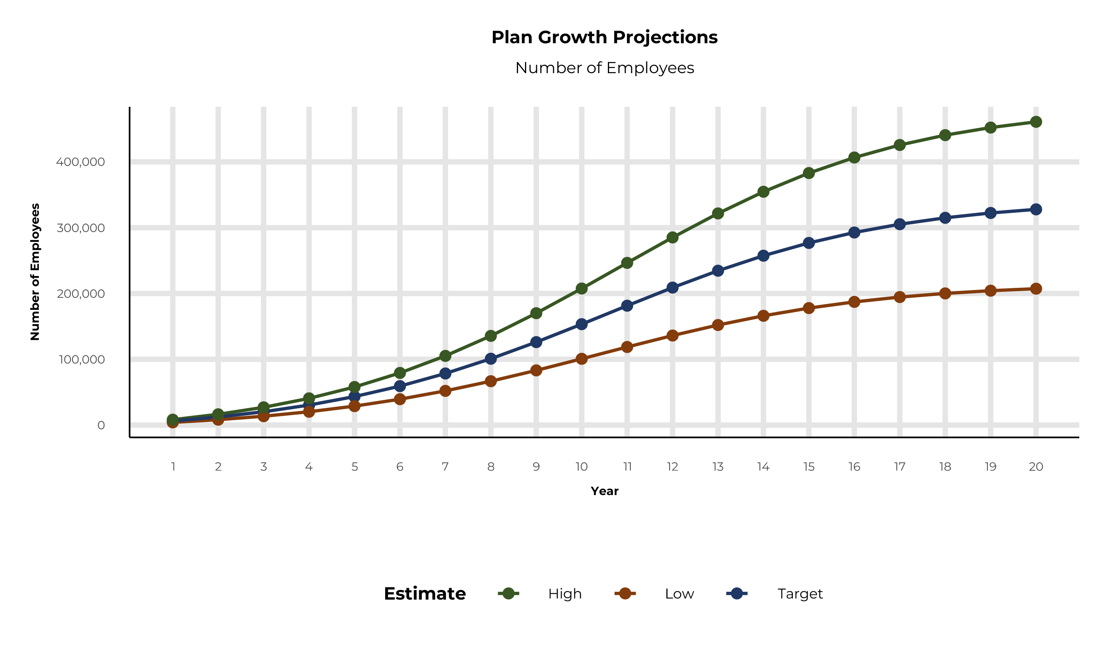
PLAN POTENTIAL GROWTH PATHS
Self Funded
1,498K
Insured
2,680K
Working Age
4,139K
Population
6,875K
Estimates includes the Houston Methodist service area in Austin, Brazoria, Chambers, Fort Bend, Galveston, Grimes, Harris, Liberty, Montgomery, San Jacinto, Walker, Waller, and Wharton Counties

Slide 6
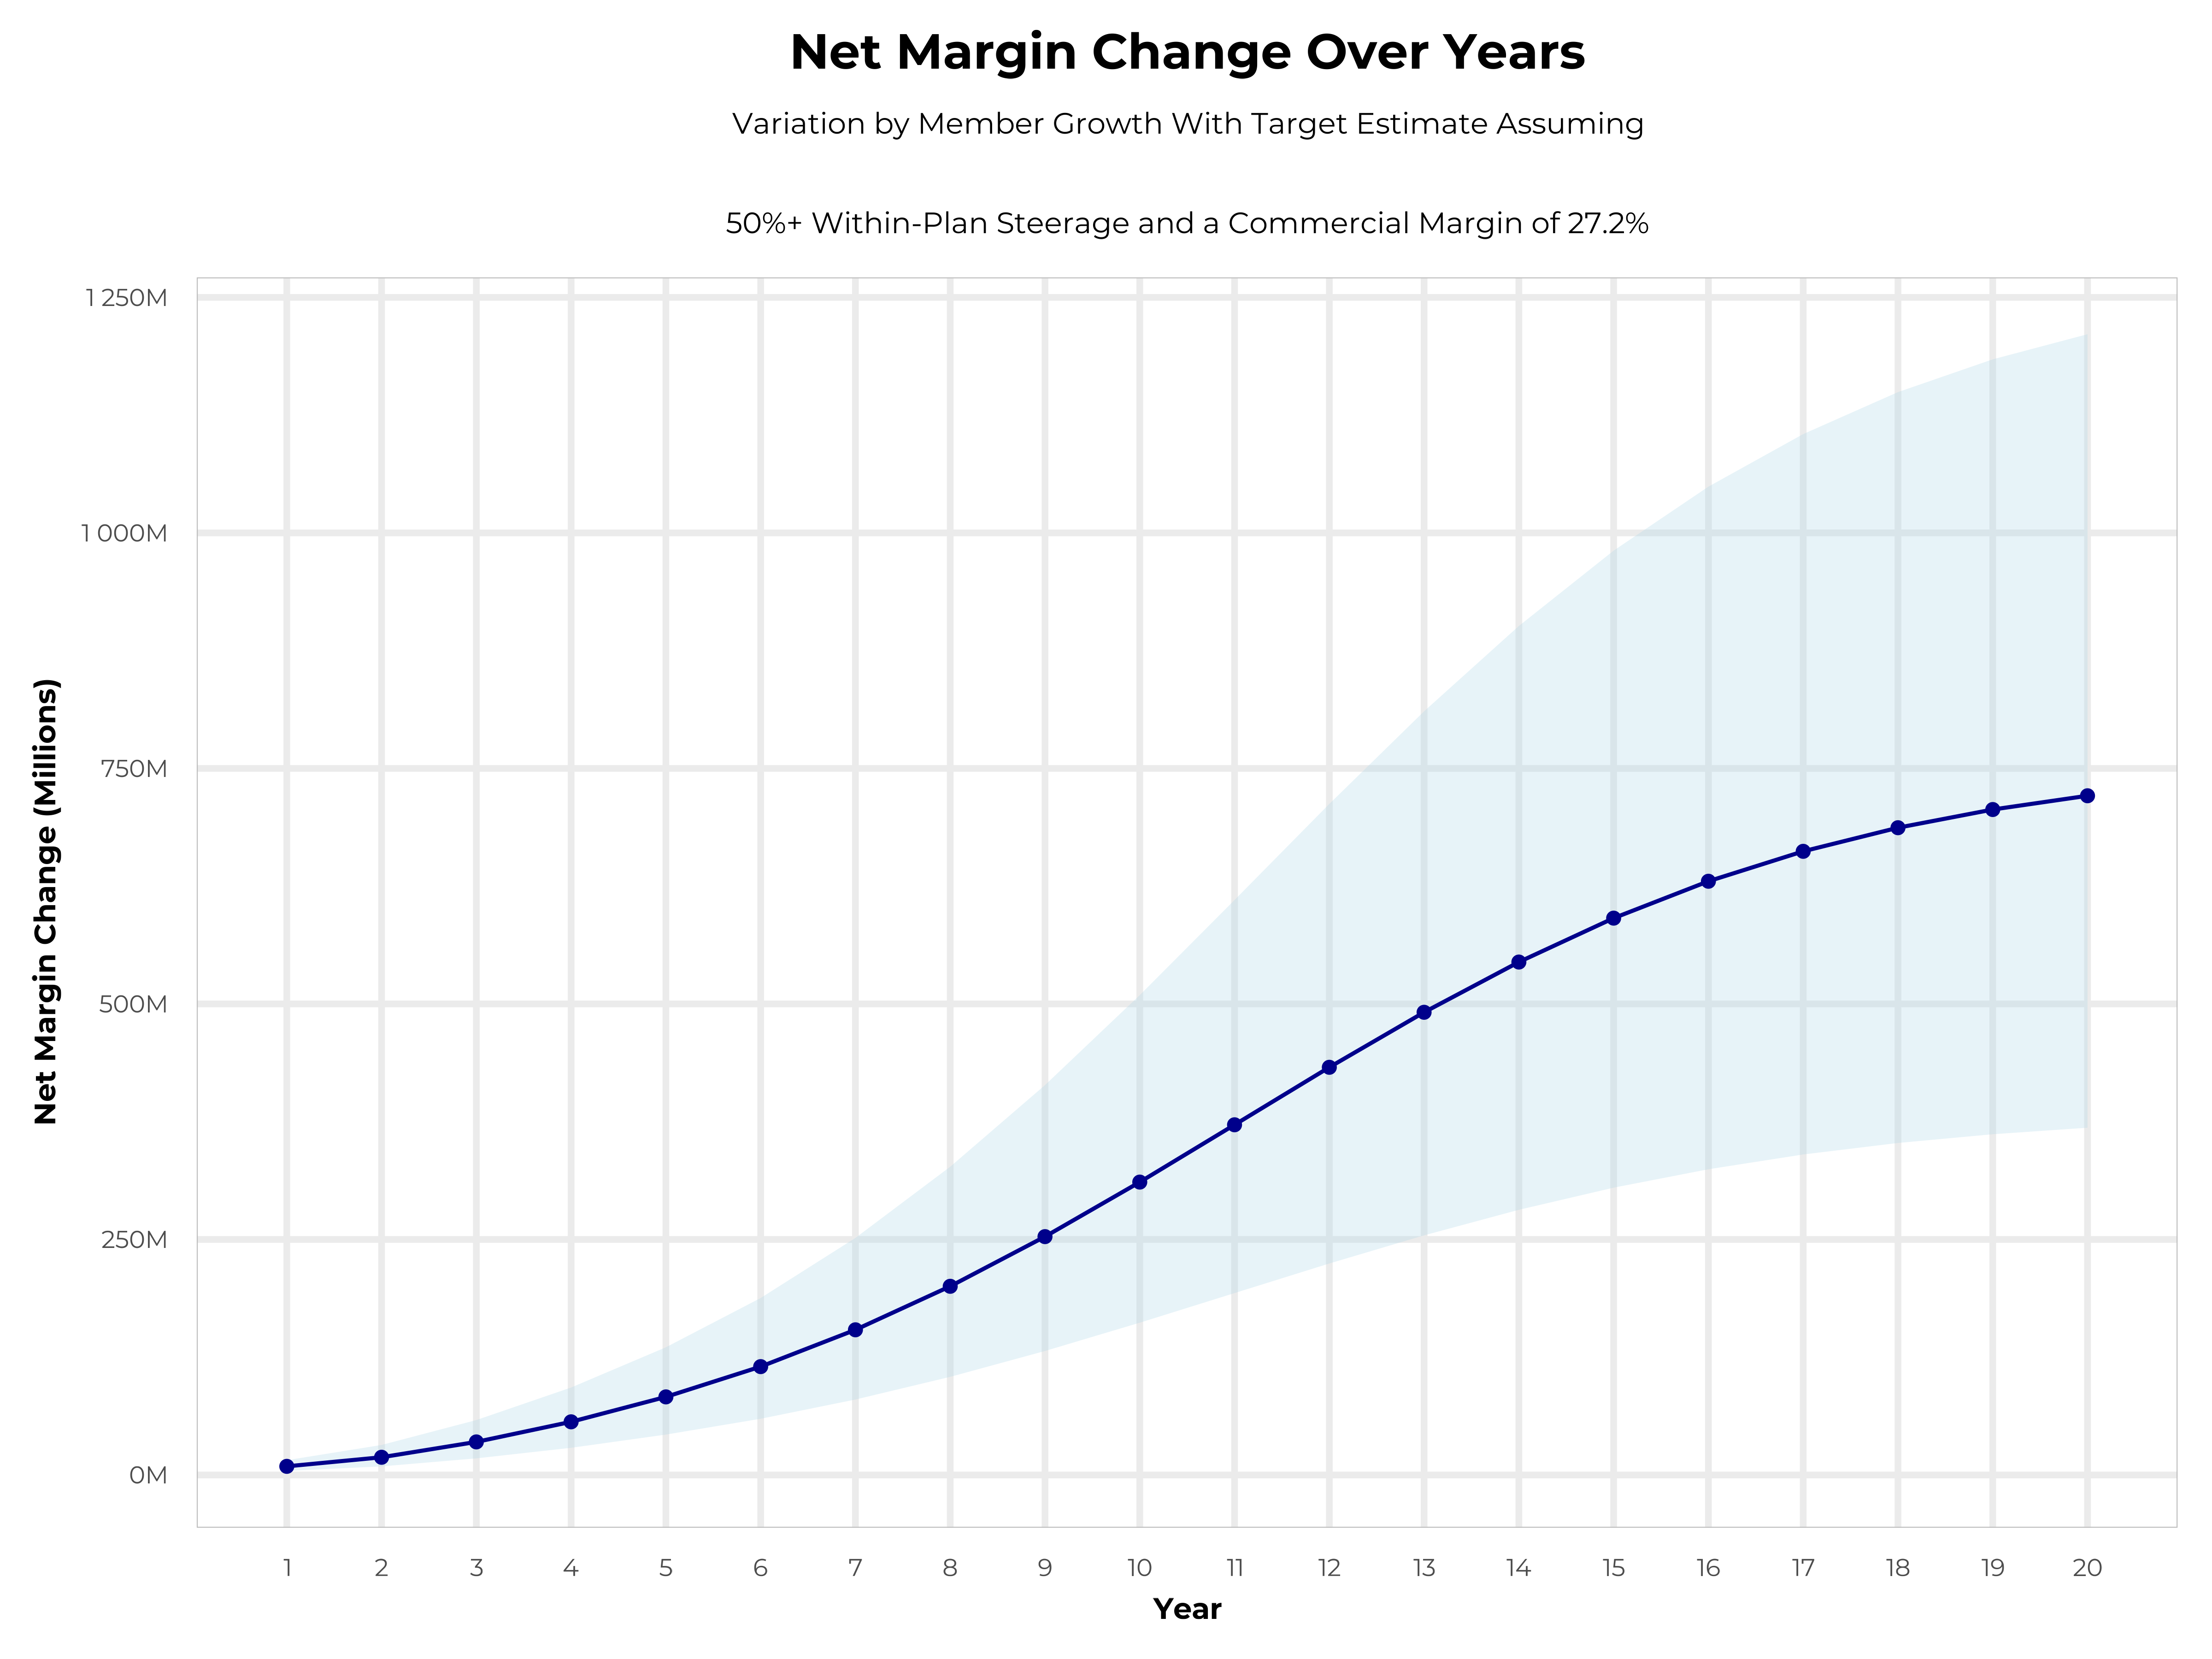
GROWING POWERFUL, LASTING PROFITABILITY
Early Stage
Gaining Name Recognition, Early Growth
New Revenue:
New Profit:
$192.73M
$52.9M
Growth Stage
Strong Reputation, Strong Growth
New Revenue:
New Profit:
$1149.79M
$316.28M
Mature Stage
High Profitability, Market Saturation
New Revenue:
New Profit:
$2359.83M
$648.88M

Slide 7
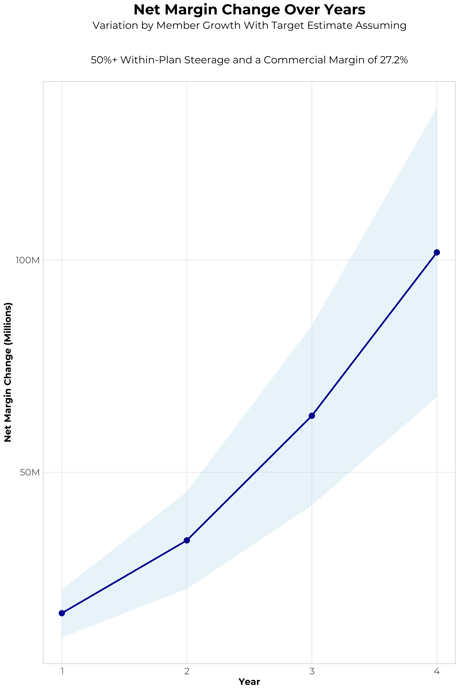
FOUR-YEAR PROJECTIONS
Target Member Growth | Target Member Growth | Target Member Growth | Target Member Growth | Target Member Growth
Metric | Year 1 | Year 2 | Year 3 | Year 4
Number of Members | 11,100 | 22,100 | 36,400 | 54,800
Incremental Margin | 17,015.0K | 33,880.6K | 63,067.1K | 101,327.9K
Network Access Fee | 133.2K | 265.2K | 436.8K | 657.6K
Implementation Fee (One-Time) | -150.0K | 0.0K | 0.0K | 0.0K
Sales and Marketing Costs | -180.0K | -180.0K | -180.0K | -180.0K
Net Margin Change | 16,818.2K | 33,965.8K | 63,323.9K | 101,805.5K
High Member Growth | High Member Growth | High Member Growth | High Member Growth | High Member Growth
Metric | Year 1 | Year 2 | Year 3 | Year 4
Number of Members | 14,700 | 29,500 | 48,600 | 73,100
Incremental Margin | 22,533.4K | 45,225.3K | 84,205.0K | 135,165.6K
Network Access Fee | 176.4K | 354.0K | 583.2K | 877.2K
Implementation Fee (One-Time) | -150.0K | 0.0K | 0.0K | 0.0K
Sales and Marketing Costs | -180.0K | -180.0K | -180.0K | -180.0K
Net Margin Change | 22,379.8K | 45,399.3K | 84,608.2K | 135,862.8K
Low Member Growth | Low Member Growth | Low Member Growth | Low Member Growth | Low Member Growth
Metric | Year 1 | Year 2 | Year 3 | Year 4
Number of Members | 7,400 | 14,700 | 24,300 | 36,500
Incremental Margin | 11,343.3K | 22,536.0K | 42,102.5K | 67,490.3K
Network Access Fee | 88.8K | 176.4K | 291.6K | 438.0K
Implementation Fee (One-Time) | -150.0K | 0.0K | 0.0K | 0.0K
Sales and Marketing Costs | -180.0K | -180.0K | -180.0K | -180.0K
Net Margin Change | 11,102.1K | 22,532.4K | 42,214.1K | 67,748.3K

Slide 8
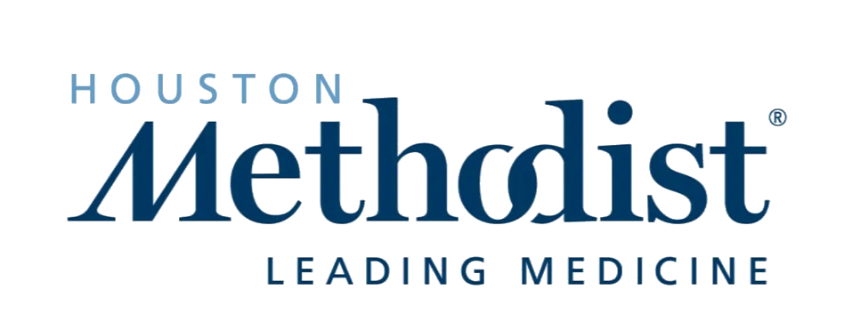
DIRECT-TO-EMPLOYER STRATEGY: ONLY AVAILABLE TO PREMIER HEALTH SYSTEMS
STRONG Brand Quality
EXTENSIVE Patient Access
AFFORDABLE Value Pricing
EXCELLENT Care Quality

Slide 9
HOUSTON METHODIST IS PATIENT RECOMMENDED
Health System | HCAHPS Recommendation Percentile | CMS Stars Percentile | Mortality Percentile | Readmission Percentile | KBA Brand Quality Score
Houston Methodist | 85 | 98 | 83 | 65 | 74
Other Independent Hospitals | 42 |  | 57 | 73 | 71
Harris Health System | 60 | 63 | 67 | 59 | 68
Memorial Hermann Health System | 56 | 63 | 69 | 58 | 66
CommonSpirit Health | 45 | 72 | 76 | 62 | 61
Department of Veterans Affairs | 41 | 90 | 86 | 58 | 58
OakBend Medical Center Health System | 21 | 31 | 58 | 68 | 52
HCA Healthcare | 18 | 50 | 78 | 54 | 50
Community Hospital Corporation | 14 | 63 | 69 | 58 | 49
Healthcare Systems of America | 12 | 31 | 67 | 86 | 47
Based on quality measures and HCAHPS feedback, KBA estimates that Houston Methodist has the strongest brand quality in Austin, Brazoria, Chambers, Fort Bend, Galveston, Grimes, Harris, Liberty, Montgomery, San Jacinto, Walker, Waller, and Wharton Counties.

Slide 10


Complete Marketing System
Customized Branding and Messaging
Customized Brochures
Customized Web Site
Targeted Employer Outreach
Sales System (Social Media, Email, Text, etc.)

Slide 11
PROJECTED PLAN GROWTH
Year | Employees | Members | Percent of Members Choosing Houston Methodist for Inpatient Care | Percent of Members Choosing Houston Methodist for Outpatient Care
1 | 6,100 | 11,000 | 60% | 50%
2 | 12,300 | 22,100 | 60% | 50%
3 | 20,200 | 36,400 | 65% | 55%
4 | 30,400 | 54,700 | 67% | 58%
5 | 43,300 | 77,900 | 68% | 60%
6 | 59,200 | 106,600 | 68% | 60%
7 | 78,400 | 141,100 | 69% | 61%
8 | 100,800 | 181,400 | 69% | 62%
9 | 126,100 | 227,000 | 69% | 62%
10 | 153,400 | 276,100 | 70% | 63%
11 | 181,400 | 326,500 | 70% | 63%
12 | 209,000 | 376,200 | 70% | 64%
13 | 234,600 | 422,300 | 71% | 64%
14 | 257,400 | 463,300 | 71% | 65%
15 | 276,800 | 498,200 | 71% | 66%
16 | 292,700 | 526,900 | 72% | 66%
17 | 305,300 | 549,500 | 72% | 66%
18 | 315,000 | 567,000 | 72% | 67%
19 | 322,400 | 580,300 | 72% | 67%
20 | 327,900 | 590,200 | 72% | 67%
KBA currently estimates that Houston Methodist has 22% inpatient market share, and 13% outpatient market compared to hospitals/clinics in the Houston Methodist service area (see slide 8).
Based on previous DTE experience, KBA expects a significant bump in patient steerage to Houston Methodist.
Additional steerage will occur from additional steerage patient benefits and the patient convenience card.
High estimates start nearly 10% higher than target with low estimates at 10% lower than target

Slide 12





A PARTNER YOU CAN TRUST
OUR OBJECTIVES ARE ALIGNED
WE KNOW THE
MARKET
COMPLETELY TRANSPARENT
WE HAVE THE SOPHISTICATION AND INFRASTRUCTURE TO EFFECTIVELY COMPETE
Derek Moore, Senior Vice President – KBA
845-283-9973 * derek.moore@keybenefit.com

